Slide 1

Swan Teleco Retention Strategies
Information Deck
By Churn No More - Katrina, Arif, Joseph

Slide 2
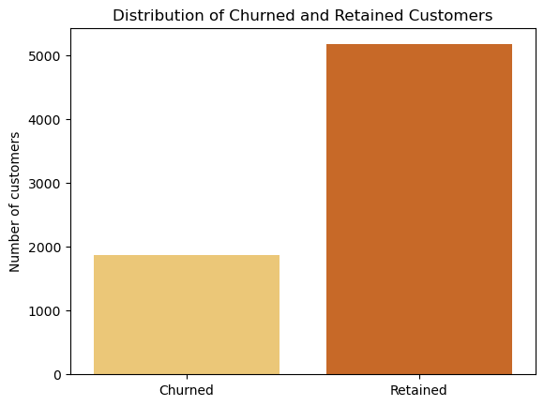
Churn vs Non-Churn
The majority of customers in the dataset (73%) have not churned.
Overall, the churned customers are female, have no partners or dependents, and have opted only for services related to phones.
The most common internet service for these churning customers is fibre optic.

Slide 3
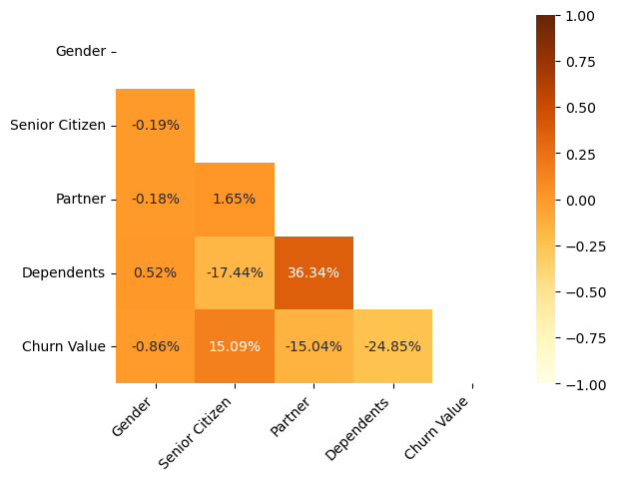
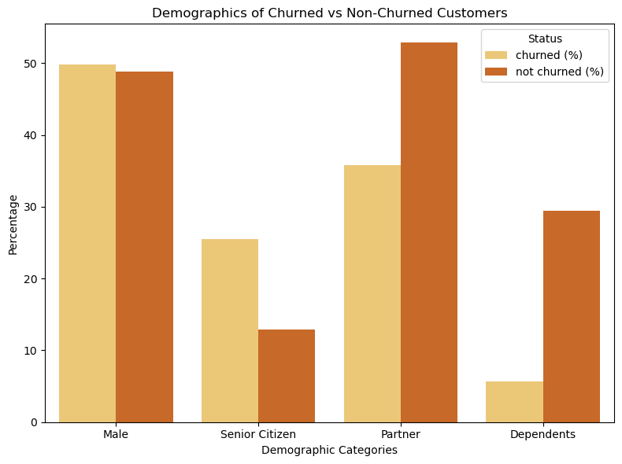
Customer Demographics
Customers with dependents and/or partners have a negative correlation with churning.
Customers that are senior citizens have a positive correlation with churning.
The percentage of senior citizens among churners is twice as high as that among non-churners.
The percentage of churners that have dependents is significantly less than the percentage of non-churners with dependents.
Senior citizens are more likely to churn whilst customers with dependents or partners are less likely to churn.

Slide 4
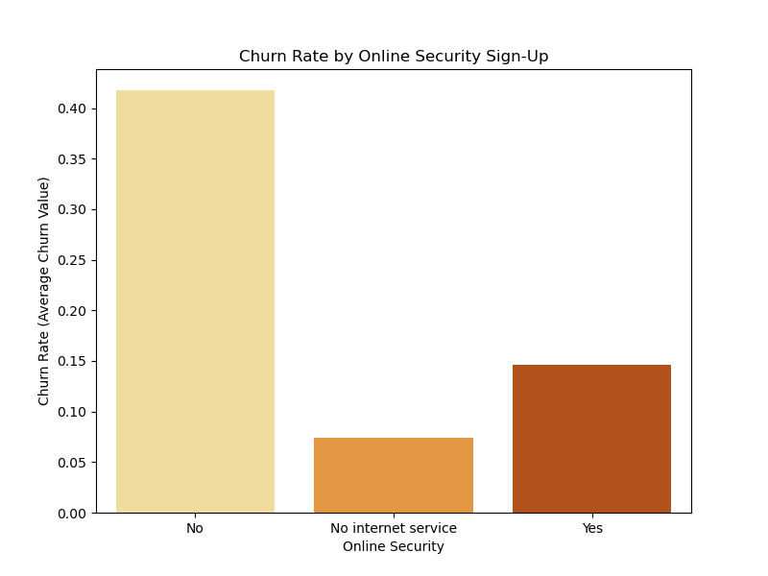
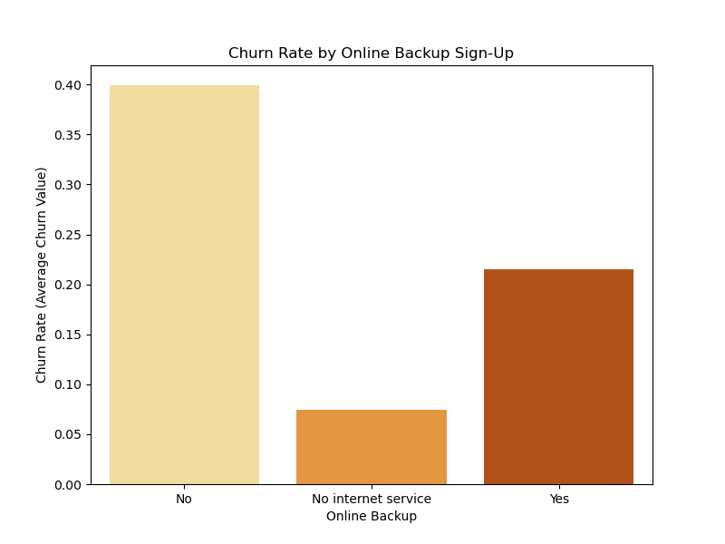
What factors retain customers best?
The 2 most influential services that Swan Teleco offer are online security and online backup.
Customers who sign up for online security services are more likely to stay.
A slightly greater proportion of customers left if they didn’t have online security compared to if they didn’t have online backup.
Hence the best sign up factor to incentivise should be online security.

Slide 5
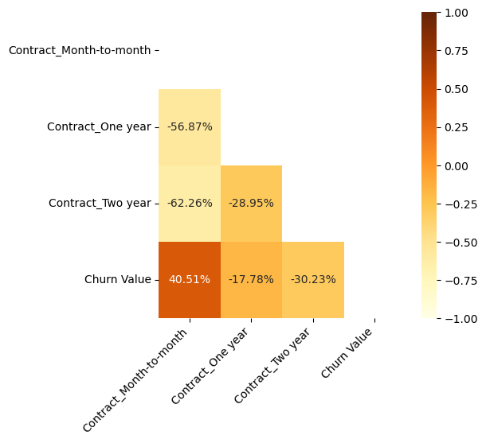
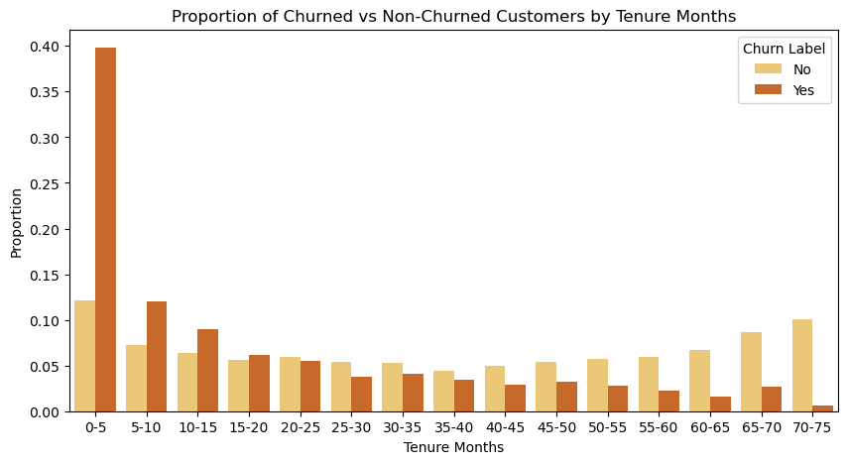
Factors Influencing Churning
Customers on Month-to-Month contracts show a positive correlation (40.51%) with Churn Value, indicating higher churn rates.
One-Year (-17.78%) and Two-Year Contracts (-30.23%) have strong negative correlations with Churn Value, showing they significantly reduce churn likelihood.
Customers with 0-5 months tenure show the highest churn proportion (~40%), indicating early-stage churn is a major issue.
Before 20 months, churned customers outnumber non-churnes in terms of proportions.
Customers with longer tenures (40-45+ months) show consistently lower churn proportions.

Slide 6
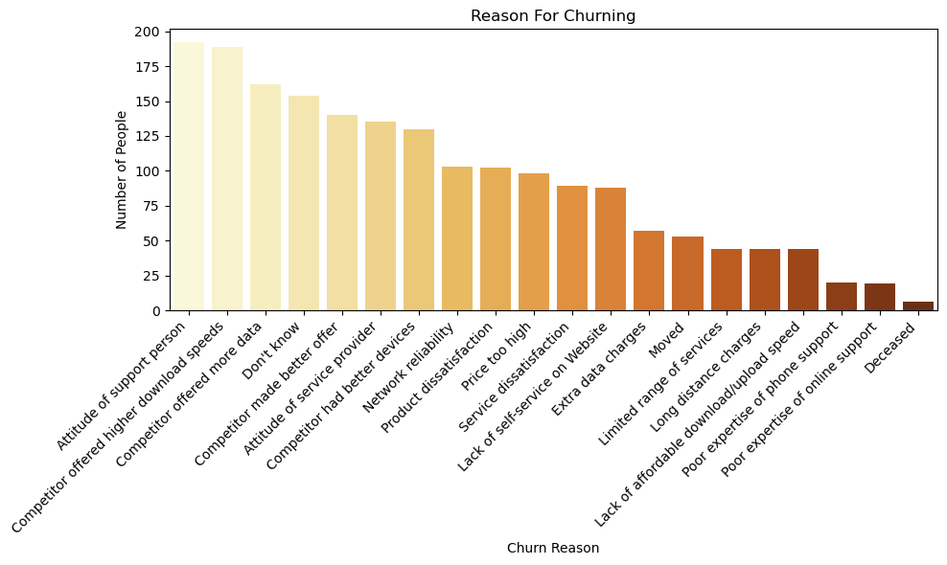
Reasons for Churning
Possible Customer Retention Strategies
Focus on the top 500 most likely to churn customer list we provided.
In particular, focus on incentivising customers who are senior citizens.
Compare your offers to your competitors and try to make your offers more appealing.
Create offers that make a one-year or two-year contract more appealing than a monthly contract.
Incentivise sign-up factors by offering customers online security and online backup.
Most customers leave due to either better offers from competitors or because of the attitude of support staff.

